Slide 1
Design and implementation patterns

Slide 2
Asynchronous Request-Reply

Slide 3
Asynchronous Request-Reply pattern
Decouple backend processing from a frontend host, where backend processing needs to be asynchronous, but the frontend still needs a clear response.

Slide 4
Context and problem
In modern application development, it's normal for client applications — often code running in a web-client (browser) — to depend on remote APIs to provide business logic and compose functionality.
These APIs may be directly related to the application or may be shared services provided by a third party. Commonly these API calls take place over the HTTP(S) protocol and follow REST semantics.

Slide 5
When to use this pattern
Use this pattern for:
Client-side code, such as browser applications, where it's difficult to provide call-back endpoints, or the use of long-running connections adds too much additional complexity.
Service calls where only the HTTP protocol is available and the return service can't fire callbacks because of firewall restrictions on the client-side.
Service calls that need to be integrated with legacy architectures that don't support modern callback technologies such as WebSockets or webhooks.

Slide 6
Example
AsyncProcessingWorkAcceptor function
The AsyncProcessingWorkAcceptor function implements an endpoint that accepts work from a client application and puts it on a queue for processing.
The function generates a request ID and adds it as metadata to the queue message.
The HTTP response includes a location header pointing to a status endpoint. The request ID is part of the URL path

Slide 7
public static class AsyncProcessingWorkAcceptor
{
[FunctionName("AsyncProcessingWorkAcceptor")]
public static async Task<IActionResult> Run(
[HttpTrigger(AuthorizationLevel.Anonymous, "post", Route = null)] CustomerPOCO customer,
[ServiceBus("outqueue", Connection = "ServiceBusConnectionAppSetting")] IAsyncCollector<ServiceBusMessage> OutMessages,
ILogger log)
{
if (String.IsNullOrEmpty(customer.id) || String.IsNullOrEmpty(customer.customername))
{
return new BadRequestResult();
}

Slide 8
Claim Check

Slide 9
What is Claim-Check pattern
Split a large message into a claim check and a payload. Send the claim check to the messaging platform and store the payload to an external service.
This pattern allows large messages to be processed, while protecting the message bus and the client from being overwhelmed or slowed down.
This pattern also helps to reduce costs, as storage is usually cheaper than resource units used by the messaging platform.

Slide 10
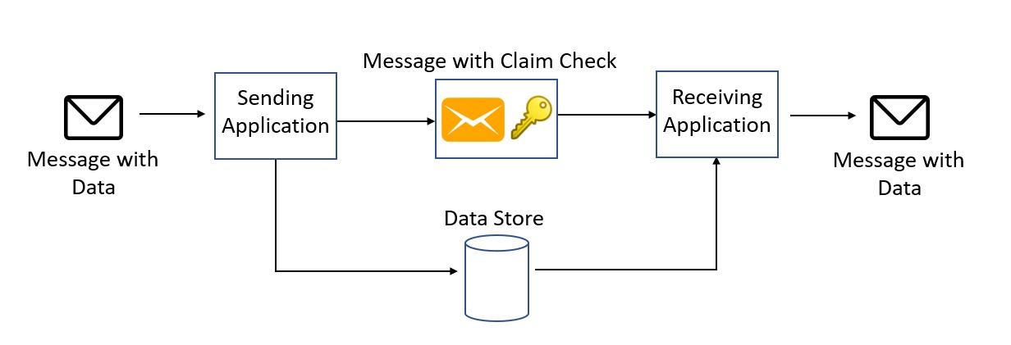
Solution
Store the entire message payload into an external service, such as a database. Get the reference to the stored payload, and send just that reference to the message bus.
The reference acts like a claim check used to retrieve a piece of luggage, hence the name of the pattern. Clients interested in processing that specific message can use the obtained reference to retrieve the payload, if needed.

Slide 11
When to use this pattern
This pattern could be used whenever a message cannot fit the supported message limit of the chosen message bus technology. For example, Service Bus currently has a limit of 100 MB (premium tier), while Event Grid supports up to 1 MB messages.
The pattern can also be used if the payload should be accessed only by services that are authorized to see it. By offloading the payload to an external resource, stricter authentication and authorization rules can be put in place, to ensure that security is enforced when sensitive data is stored in the payload.

Slide 12
// Creating and registering the sender using Service Bus Connection String and Queue Name
var sender = new MessageSender(serviceBusConnectionString, queueName);
sender.RegisterAzureStorageAttachmentPlugin(config);
// Create payload
var payload = new { data = "random data string for testing" };
var serialized = JsonConvert.SerializeObject(payload);
var payloadAsBytes = Encoding.UTF8.GetBytes(serialized);
var message = new Message(payloadAsBytes);
// Send the message
await sender.SendAsync(message);

Slide 13
Choreography

Slide 14
What is Choreography pattern
Have each component of the system participate in the decision-making process about the workflow of a business transaction, instead of relying on a central point of control.

Slide 15
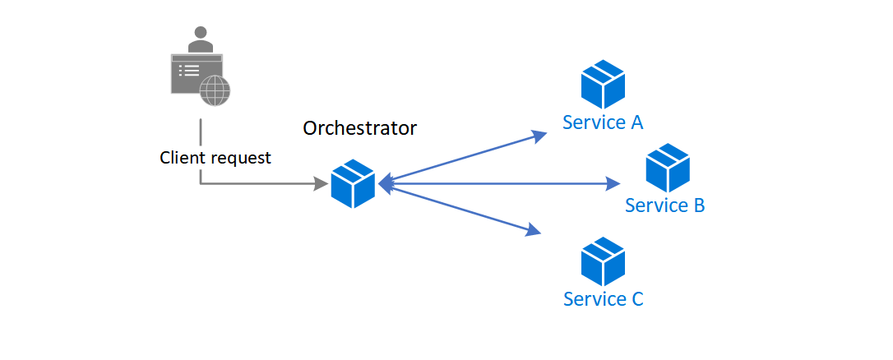
The orchestrator pattern reduces point-to-point communication between services but has some drawbacks because of the tight coupling between the orchestrator and other services that participate in processing of the business transaction.
To execute tasks in a sequence, the orchestrator needs to have some domain knowledge about the responsibilities of those services. If you want to add or remove services, existing logic will break, and you'll need to rewire portions of the communication path. While you can configure the workflow, add or remove services easily with a well-designed orchestrator, such an implementation is complex and hard to maintain.

Slide 16
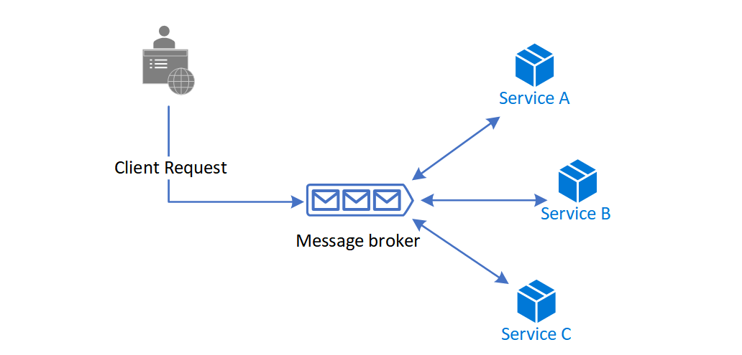
Solution
Let each service decide when and how a business operation is processed, instead of depending on a central orchestrator.
One way to implement choreography is to use the asynchronous messaging pattern to coordinate the business operations.

Slide 17
When to use this pattern
Use the choreography pattern if you expect to update, remove, or add new services frequently. The entire app can be modified with lesser effort and minimal disruption to existing services.
Consider this pattern if you experience performance bottlenecks in the central orchestrator.
This pattern is a natural model for the serverless architecture where all services can be short lived, or event driven. Services can spin up because of an event, do their task, and are removed when the task is finished.

Slide 18
example
[HttpPost]
[Route("/api/[controller]/operation")]
[ProducesResponseType(typeof(void), 200)]
[ProducesResponseType(typeof(void), 400)]
[ProducesResponseType(typeof(void), 500)]
public async Task<IActionResult> Post([FromBody] EventGridEvent[] events)
{
if (events == null)
{
return BadRequest("No Event for Choreography");
}

Slide 19
Competing Consumers

Slide 20
What is Competing Consumers pattern
Enable multiple concurrent consumers to process messages received on the same messaging channel. With multiple concurrent consumers, a system can process multiple messages concurrently to optimize throughput, to improve scalability and availability, and to balance the workload.

Slide 21
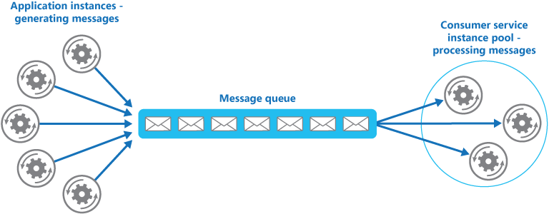

Slide 22
Solution
Use a message queue to implement the communication channel between the application and the instances of the consumer service. The application posts requests in the form of messages to the queue, and the consumer service instances receive messages from the queue and process them.
This approach enables the same pool of consumer service instances to handle messages from any instance of the application. The figure illustrates using a message queue to distribute work to instances of a service.

Slide 23
Issues and considerations
Message ordering
Designing services for resiliency
Detecting poison messages
Handling results
Scaling the messaging system
Ensuring reliability of the messaging system

Slide 24
When to use this pattern
Use this pattern when:
The workload for an application is divided into tasks that can run asynchronously.
Tasks are independent and can run in parallel.
The volume of work is highly variable, requiring a scalable solution.
The solution must provide high availability, and must be resilient if the processing for a task fails.

Slide 25
example
Azure provides Service Bus Queues and Azure Function queue triggers that, when combined, are a direct implementation of this cloud design pattern.
Azure Functions integrate with Azure Service Bus via triggers and bindings. Integrating with Service Bus allows you to build functions that consume queue messages sent by publishers. The publishing application(s) will post messages to a queue, and consumers, implemented as Azure Functions, can retrieve messages from this queue and handle them.

Slide 26
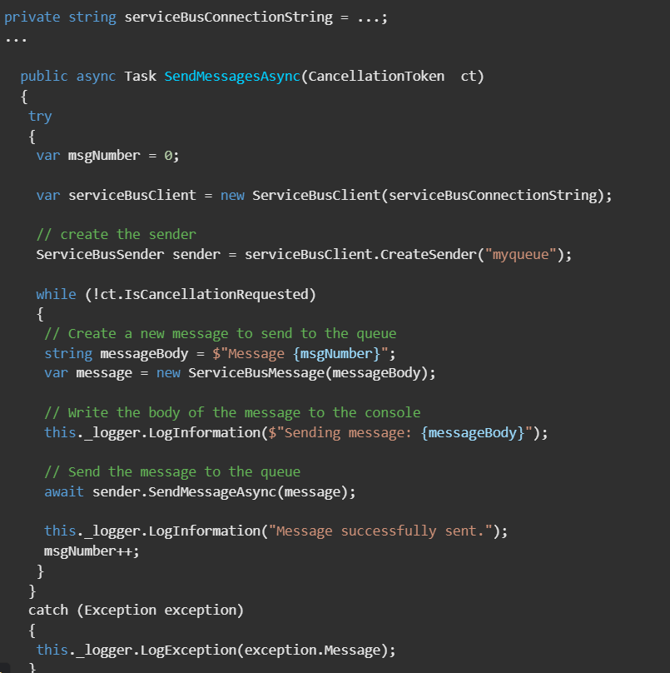

Slide 27
Gateway Aggregation

Slide 28
What is Gateway Aggregation pattern
Use a gateway to aggregate multiple individual requests into a single request. This pattern is useful when a client must make multiple calls to different backend systems to perform an operation.

Slide 29
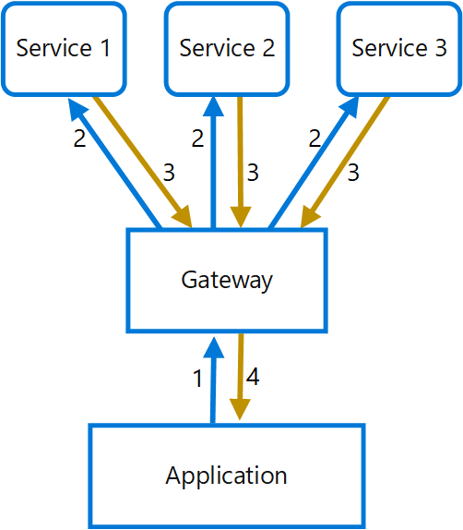
Solution

Slide 30
When to use this pattern
Use this pattern when:
A client needs to communicate with multiple backend services to perform an operation.
The client may use networks with significant latency, such as cellular networks.

Slide 31
Gateway Offloading

Slide 32
What is Gateway Offloading pattern
Offload shared or specialized service functionality to a gateway proxy. This pattern can simplify application development by moving shared service functionality, such as the use of SSL certificates, from other parts of the application into the gateway.

Slide 33
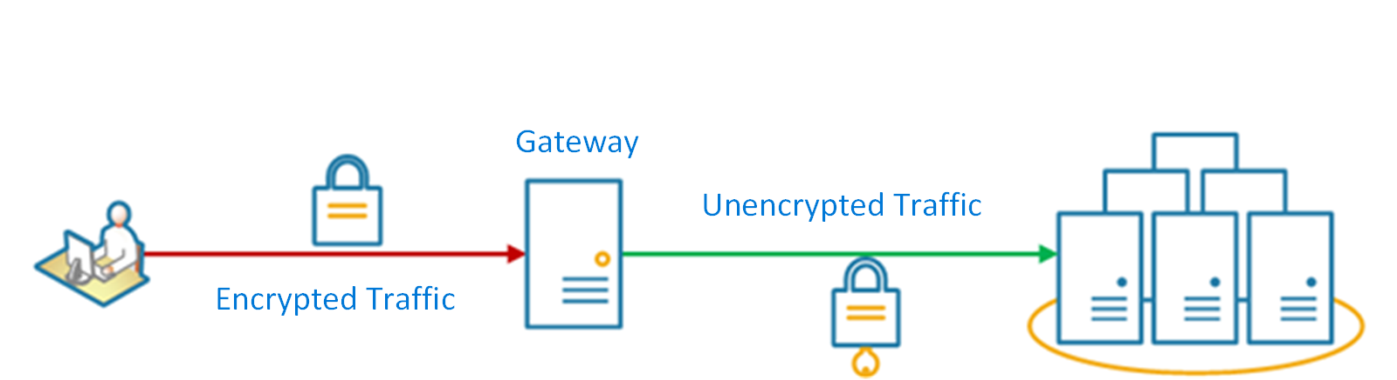
Solution
Offload some features into a gateway, particularly cross-cutting concerns such as certificate management, authentication, SSL termination, monitoring, protocol translation, or throttling.
The following diagram shows a gateway that terminates inbound SSL connections. It requests data on behalf of the original requestor from any HTTP server upstream of the gateway.

Slide 34
When to use this pattern
Use this pattern when:
An application deployment has a shared concern such as SSL certificates or encryption.
A feature that is common across application deployments that may have different resource requirements, such as memory resources, storage capacity or network connections.
You wish to move the responsibility for issues such as network security, throttling, or other network boundary concerns to a more specialized team.

Slide 35
Example
using Nginx as the SSL offload appliance, the following configuration terminates an inbound SSL connection and distributes the connection to one of three upstream HTTP servers.

Slide 36
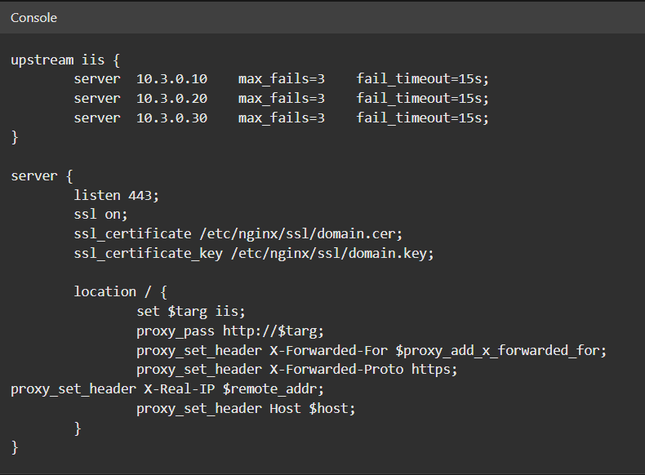

Slide 37


